Slide 1

Drowsiness Detection
Submitted By:
Pranjal Agarwal
(16eskcs739)

Slide 2
Objective:-
This project is focused on the localization of the eyes, which involves looking at the entire image of the face, and determining the position of the eyes by a self developed image-processing algorithm. Once the position of the eyes is located, the system is designed to determine whether the eyes are opened or closed, and detect fatigue..

Slide 3
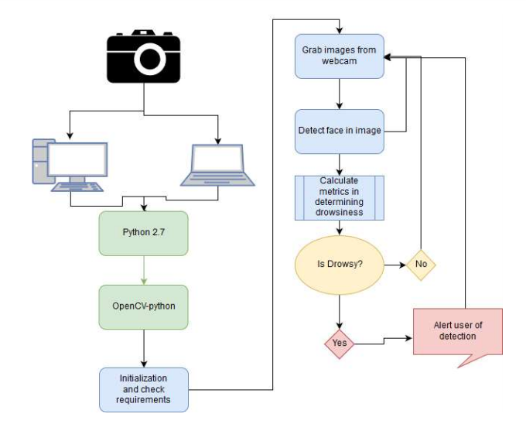
SYSTEM DESIGN SPECIFICATION:-

Slide 4
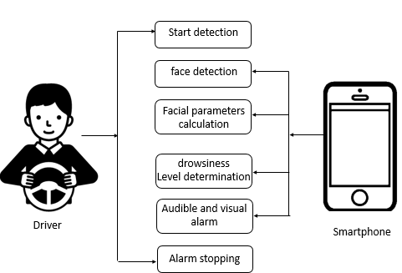

Slide 5
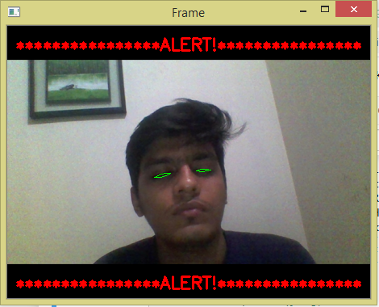
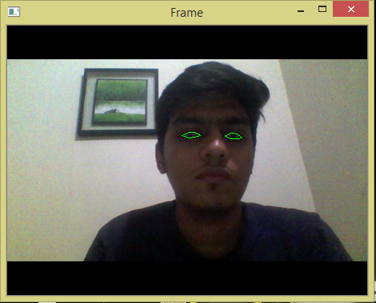
PROJECT SCREENSHOTS :-

Slide 6
PROJECT SUMMARY AND CONCLUSIONS:-
The driver abnormality monitoring system developed is capable of detecting drowsiness, drunken and reckless behaviours of driver in a short time. The Drowsiness Detection System developed based on eye closure of the driver can differentiate normal eye blink and drowsiness and detect the drowsiness while driving. The proposed system can prevent the accidents due to the sleepiness while driving.

